Slide 1





Code Club
Hello & Welcome !
TEAM
MATRIX

Slide 2

Meet the Team
Front-End Developer
Monish Kumar S S
Back-End Developer
Nithish R
Front-End Developer
Sundarakalathi K
Back-End Developer
Santhosh B

Slide 3
Our UI
Tech Stack
Home page
Front-end
01
This page shows the gist of our website and gives introduction about various features present in our website.
HTML 5
CSS - Tailwind
Bootstrap
Flex
01
Login/sign up page
Allows students to register in our site and already registered students to login into the website.Only registered students can access the events to prevent online.
02
Back-end
20
NodeJs
ExpressJs
Admin access
Database
Admins are special accessed people who post events along with the details of the event.admin access can only be given by pre-existing admins.
03
MongoDB
03

Slide 4




Our Features
Database for faster retrieval
Data is secured
Mail Services
Other Features
Complete Authentication
Google auth (for sairam students)
Github (For newcomers)
Successfully deployed in heroku
User login
Admin login
Events storage

Slide 5

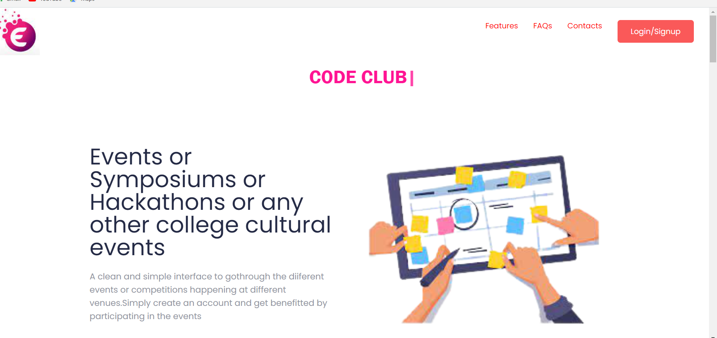
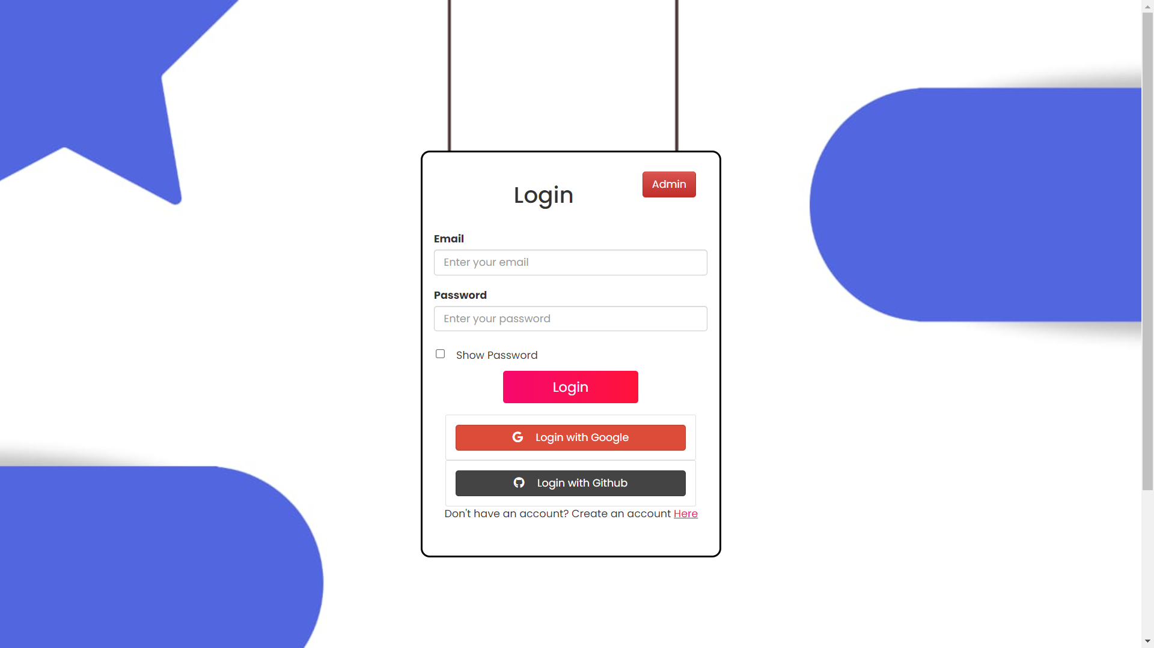
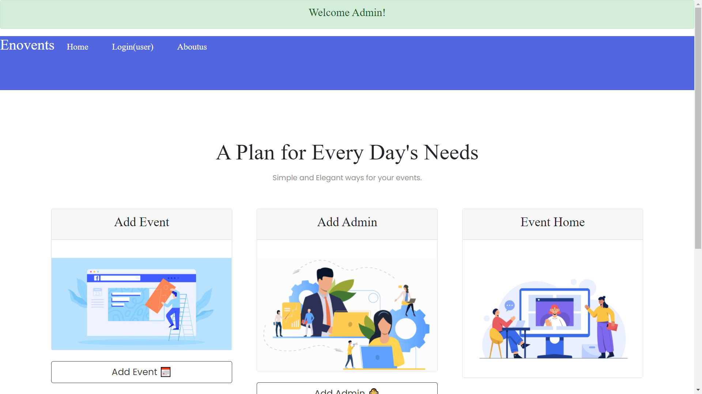
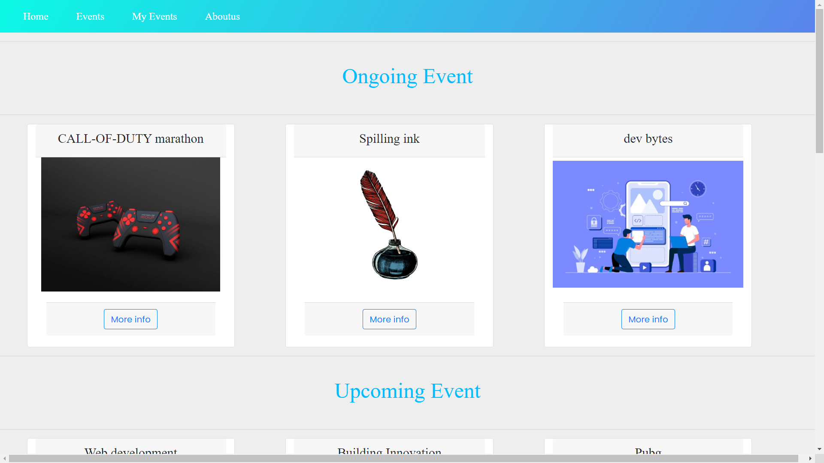


Our Work-Flow

Slide 6




Thanks For Your Time

